Slide 1
Student Name
Lavanya.D

Slide 2

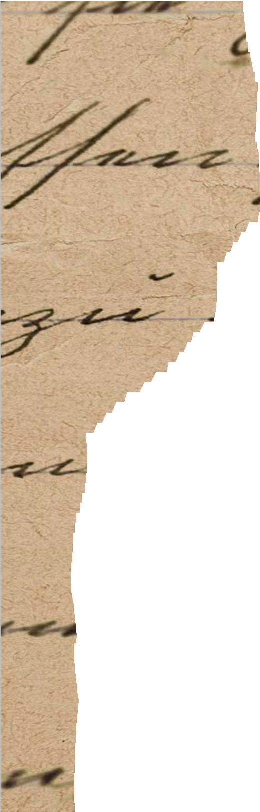
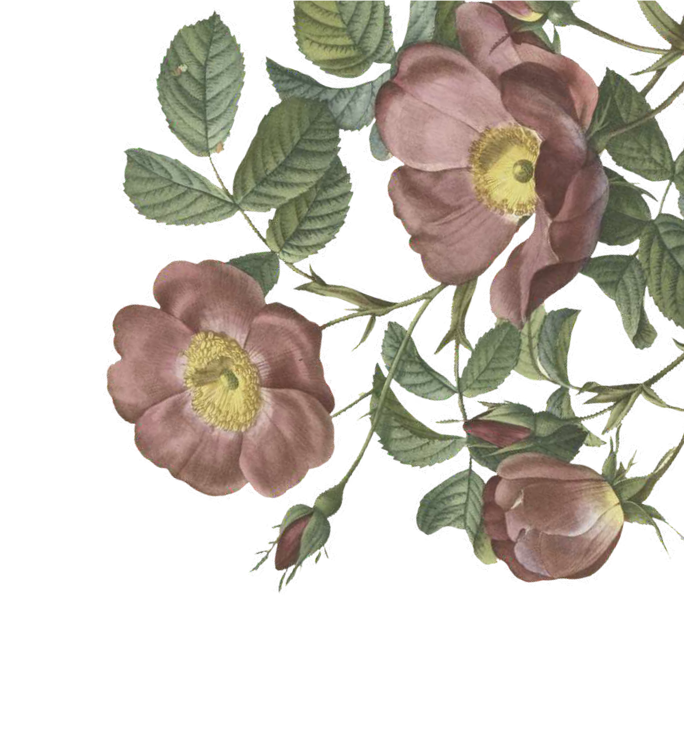
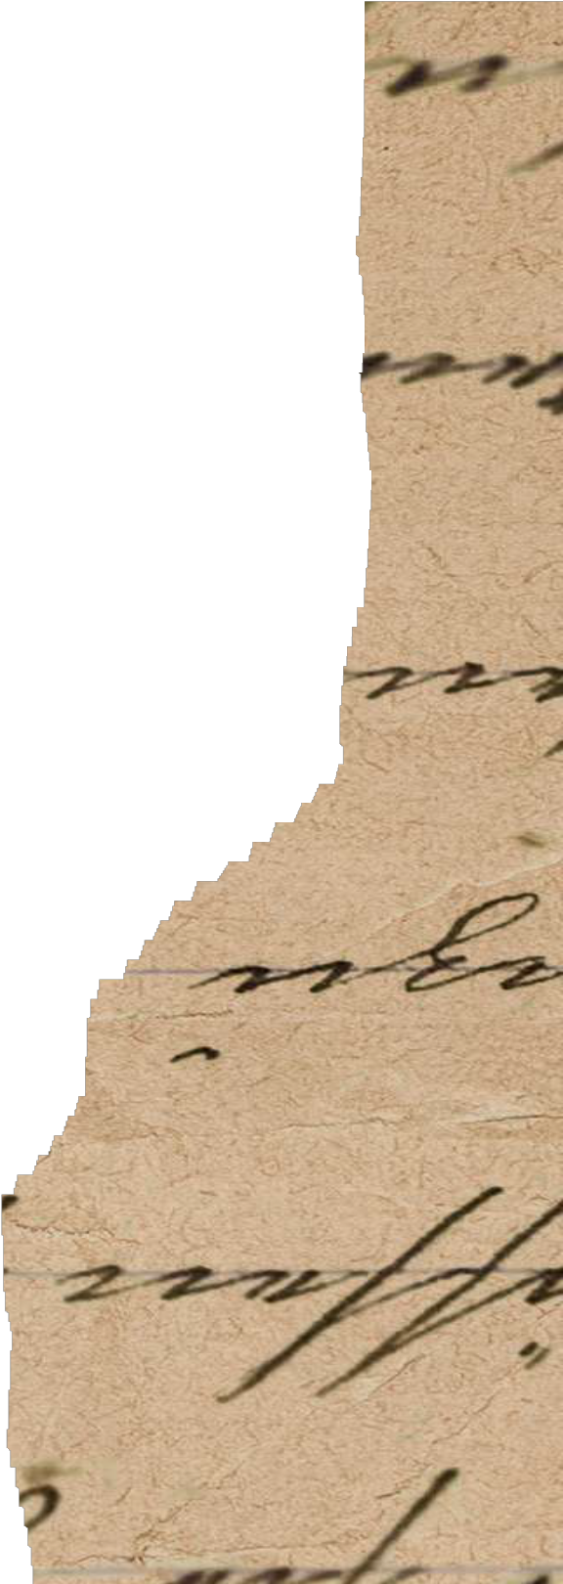
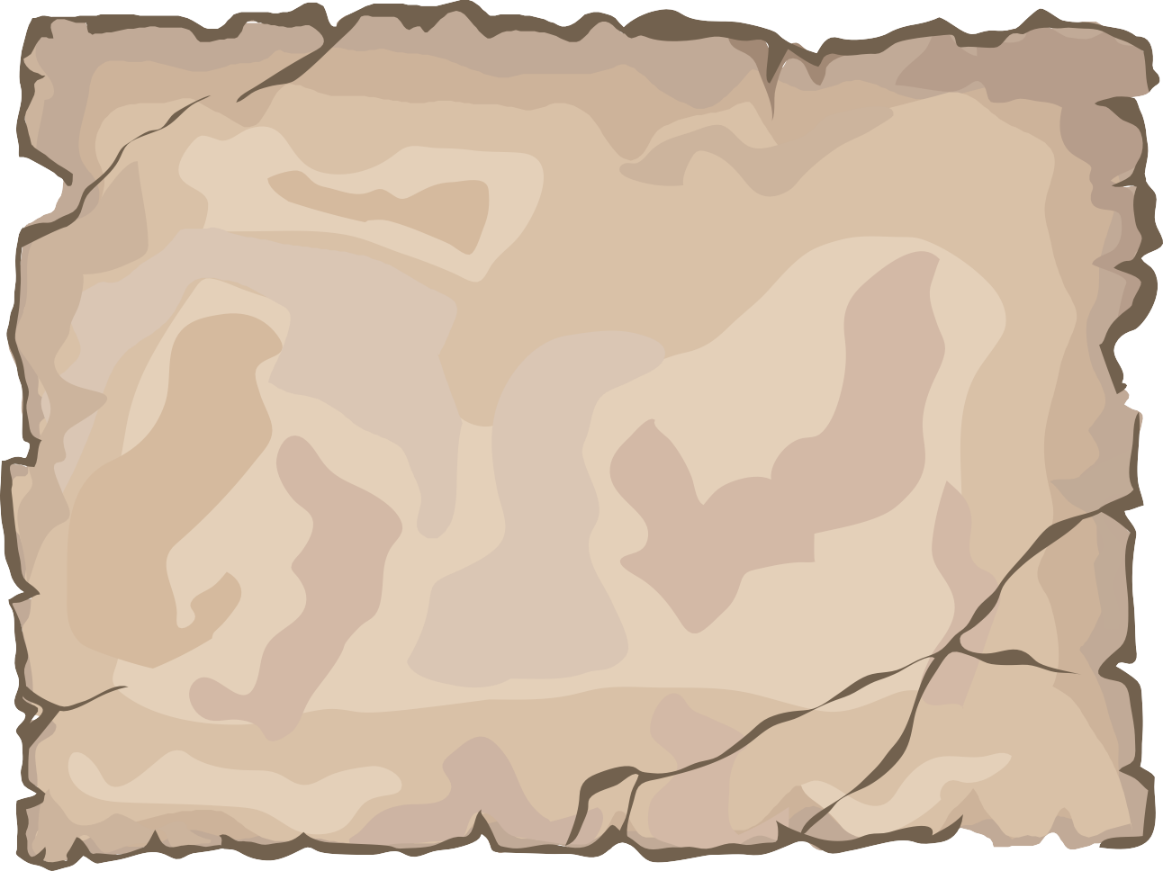
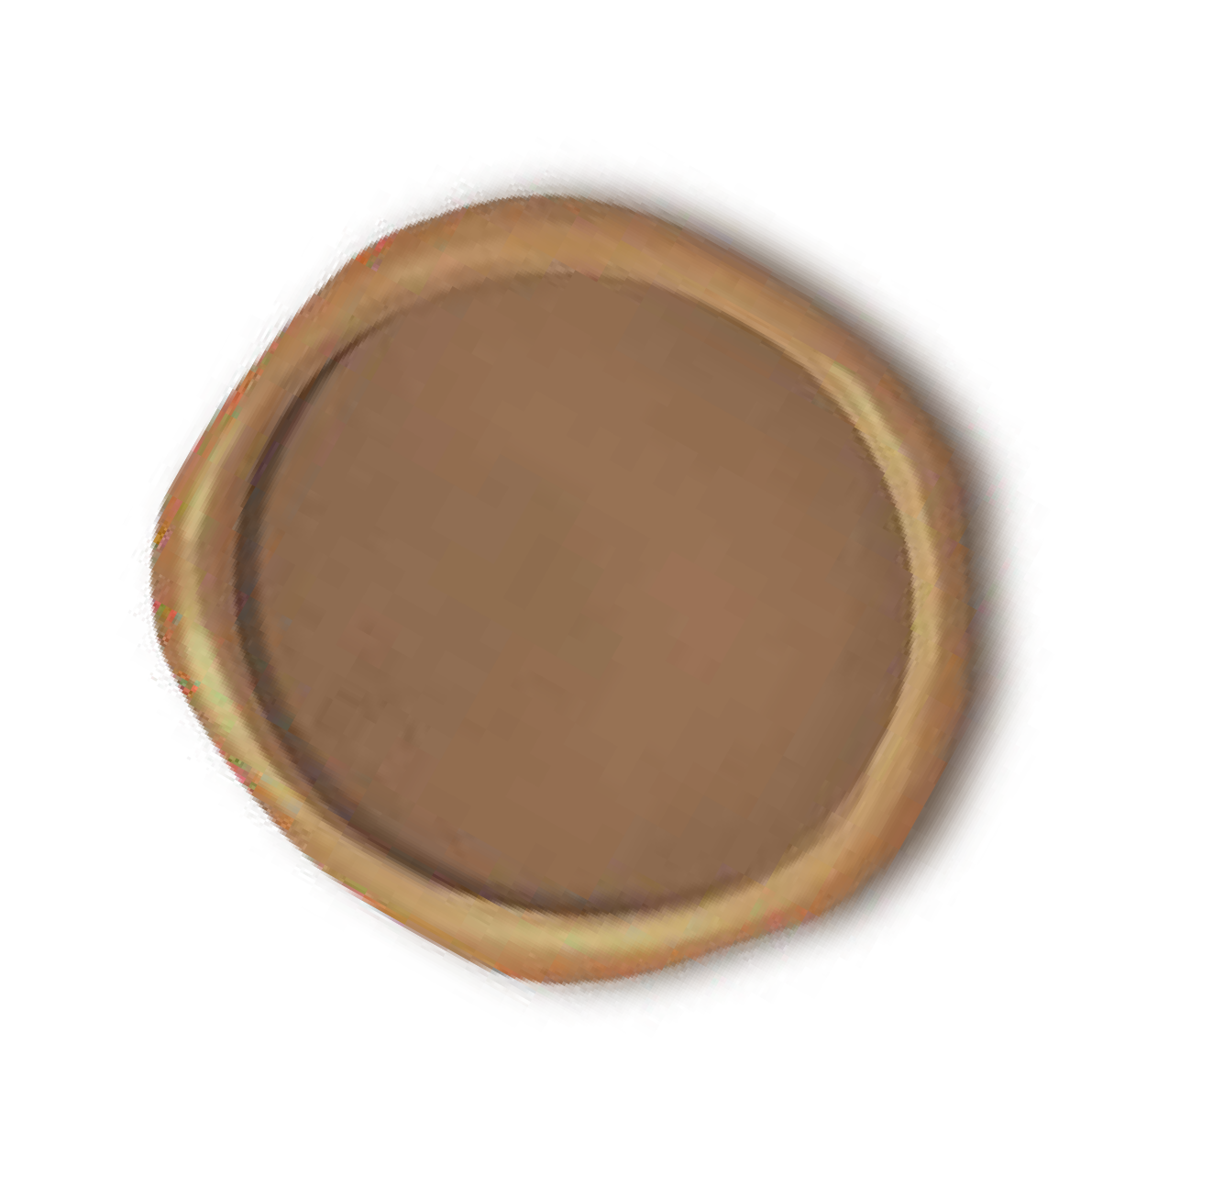



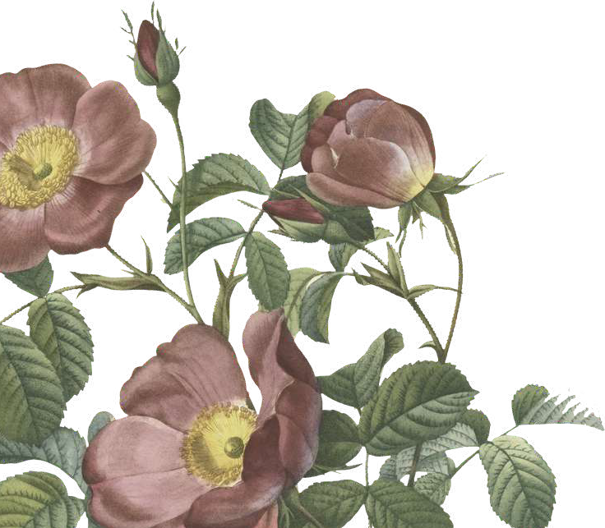
PROJECT TITLE
Generative Adversarial Network for Landscape Painting Generation

Slide 3
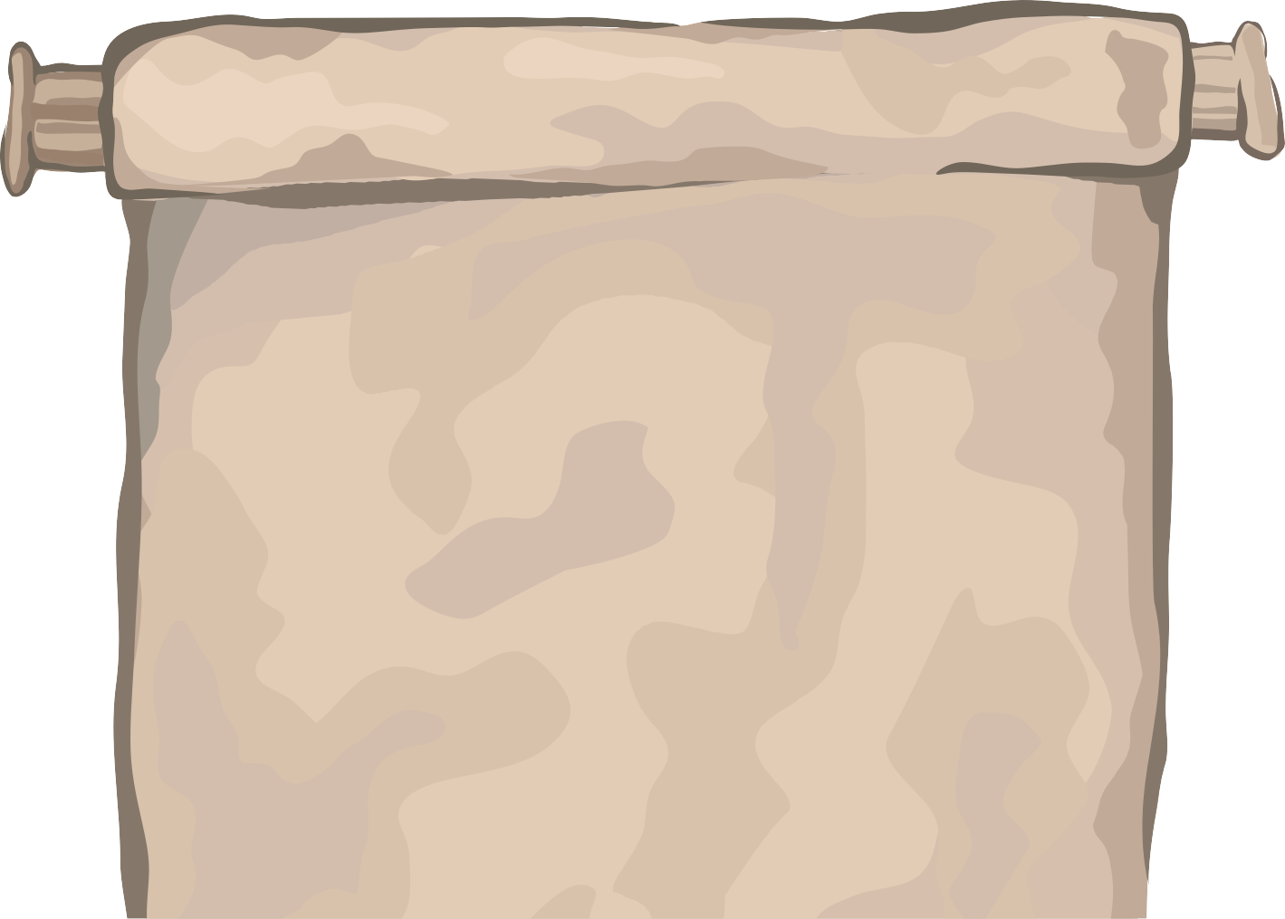
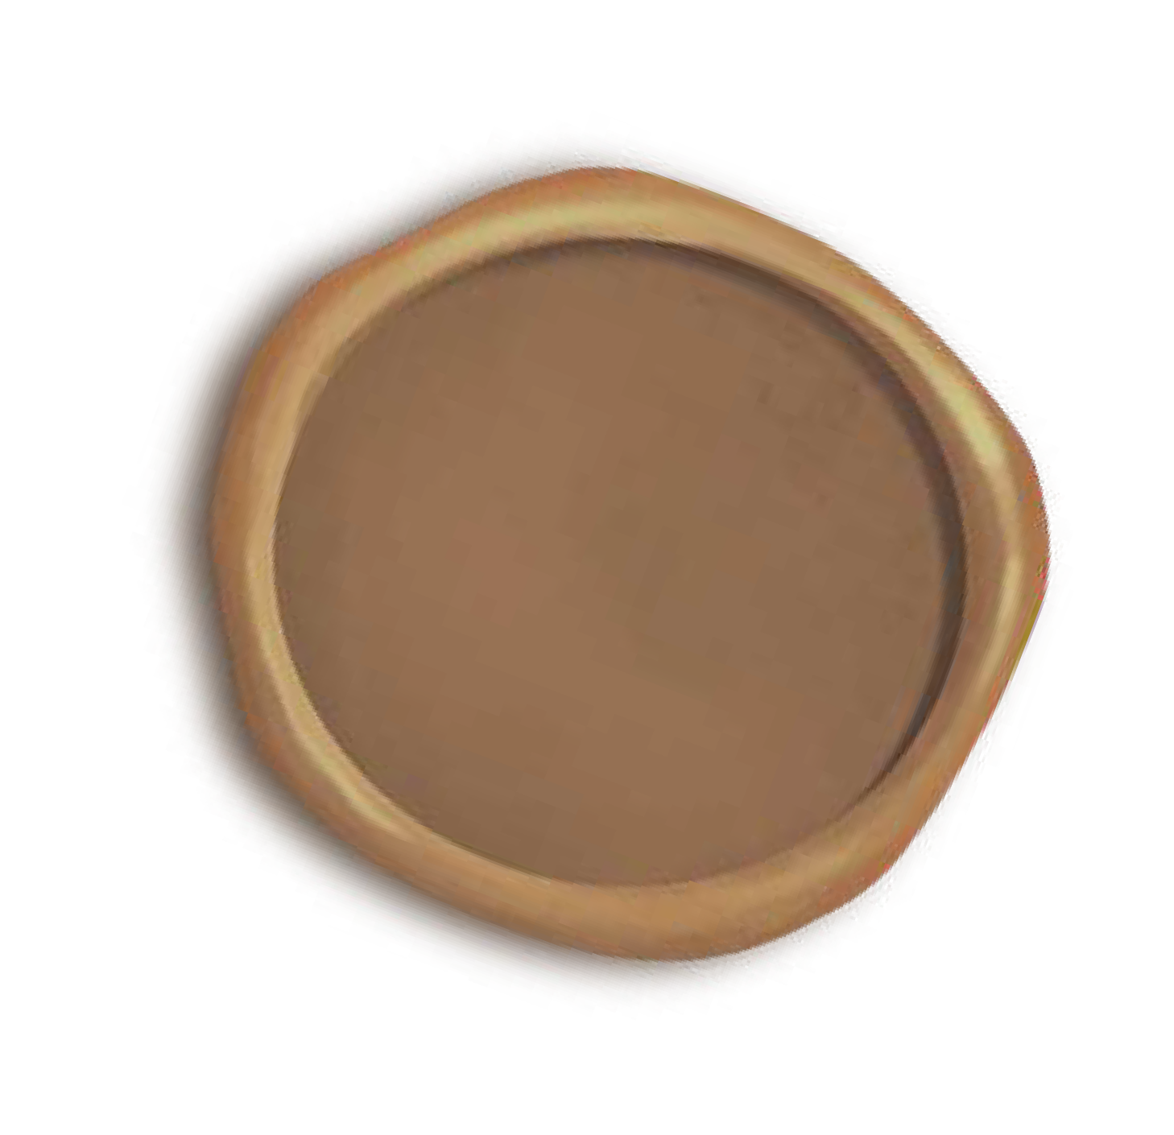

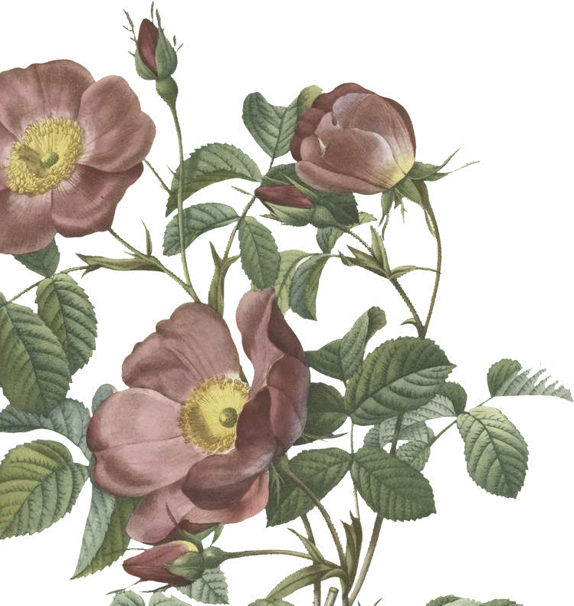
AGENDA
The agenda of this project is to develop a sophisticated generative
model using GANs specifically tailored for generating realistic and diverse
landscape paintings.

Slide 4
PROBLEM STATEMENT
The current state-of-the-art methods for generating landscape paintings often lack realism and diversity. This limitation restricts the creative options available to artists and designers, hindering their ability to produce unique and compelling artwork.

Slide 5
PROJECT OVERVIEW
The project aims to leverage the power of GANs, a class of deep learning models known for their ability to generate realistic data, to create high-quality landscape paintings. By training a GAN architecture on a vast dataset of landscape images, the goal is to develop a model that can produce visually stunning and diverse paintings that mimic natural scenes.

Slide 6
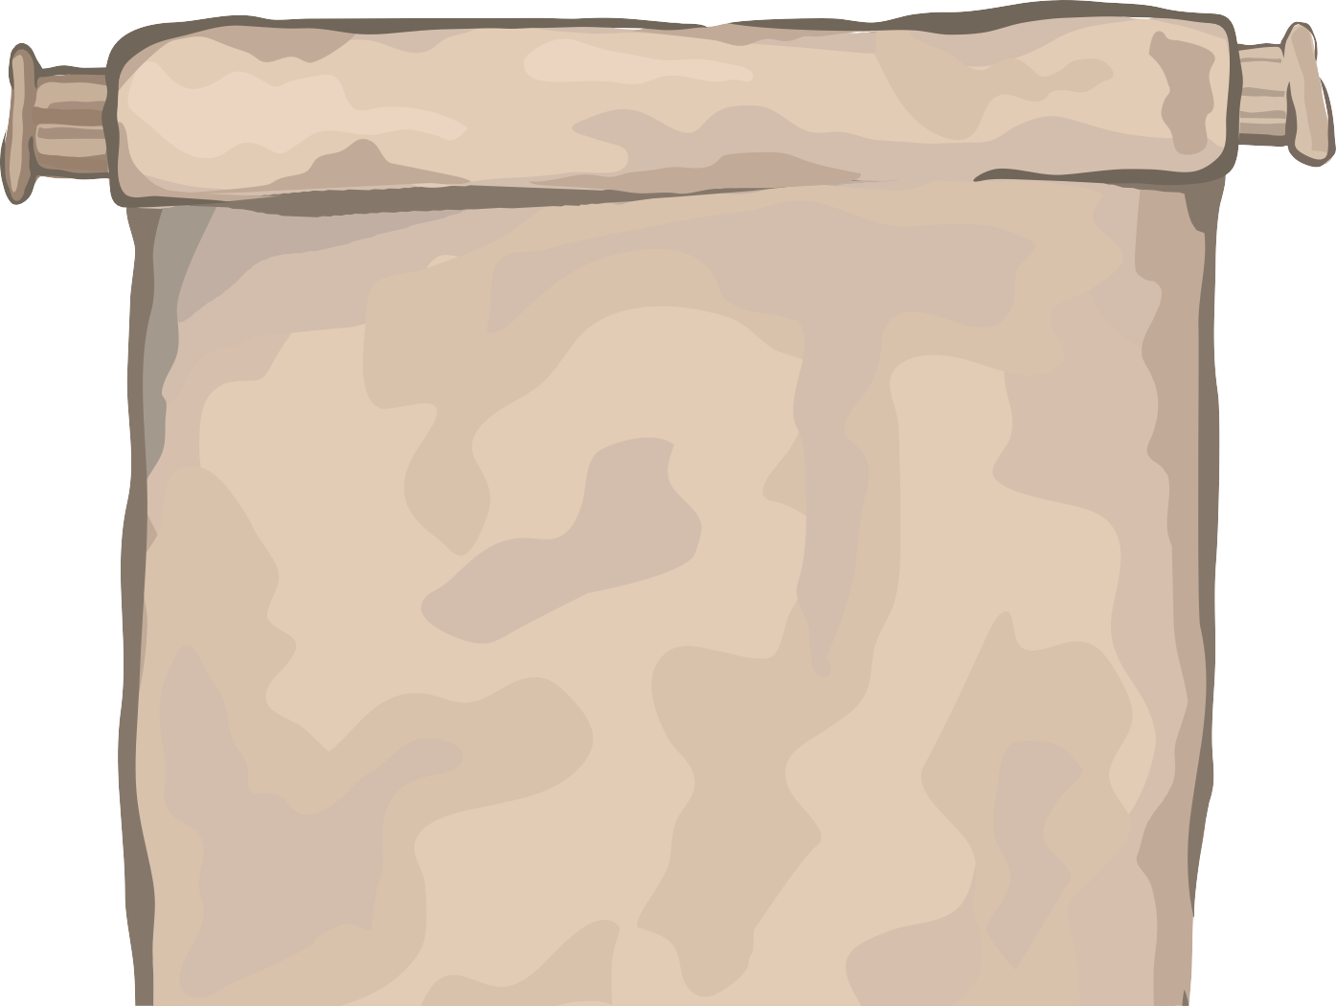

WHO ARE THE END USERS?
The end users of this project include:
Artists and painters looking for inspiration and references for their artwork.
Designers and architects who need realistic landscape visuals for their projects.
Content creators and game developers requiring digital assets for virtual environments.

Slide 7

YOUR SOLUTION AND ITS VALUE PROPOSITION
Our solution involves developing a GAN-based system that can generate high-resolution,
realistic, and diverse landscape paintings. The value proposition of our solution includes:
Time-saving and efficiency for artists and designers by providing ready-to-use visual assets.
Enhanced creativity and inspiration through Customizable painting styles and parameters.

Slide 8
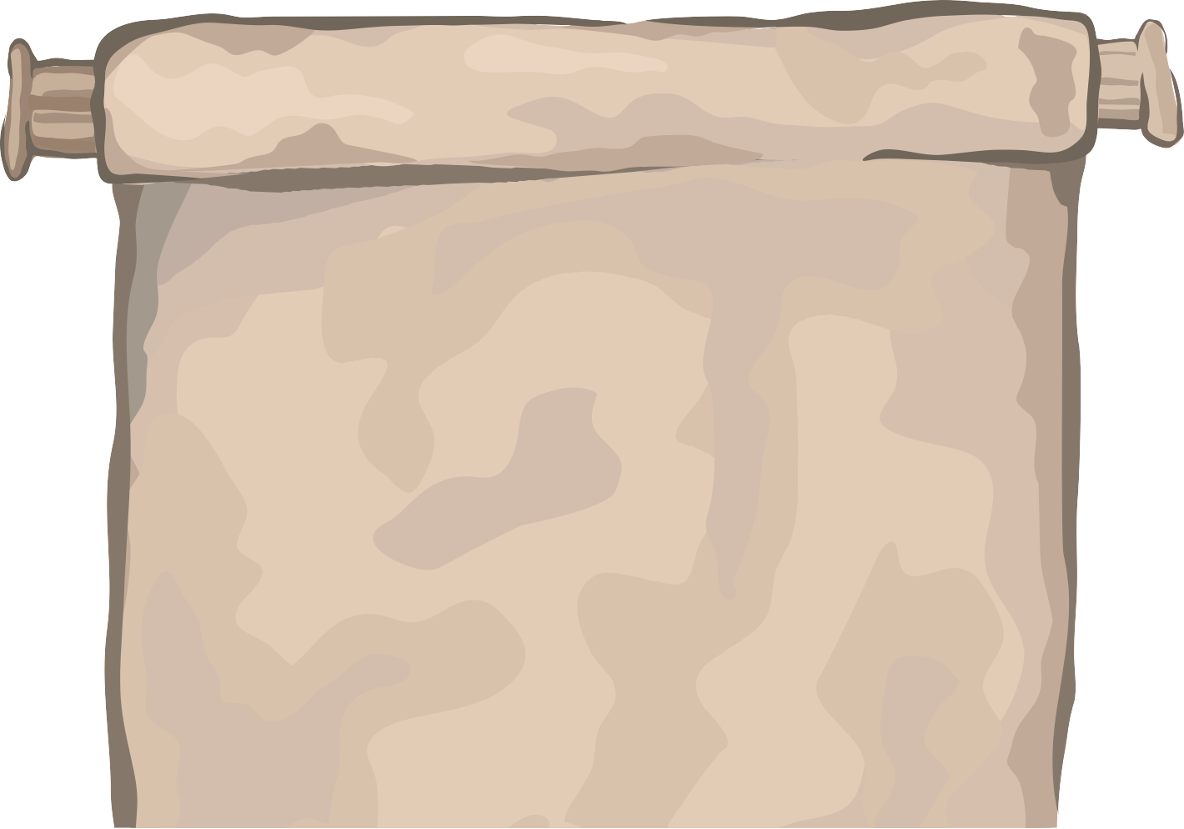


THE WOW IN YOUR SOLUTION
The wow factor in our solution lies in its ability to:
Generate lifelike landscape paintings with intricate details and natural aesthetics.
Offer a wide range of painting styles, seasons, weather conditions, and landscapes (e.g., mountains, forests, seascapes) for customization.
Provide a seamless and user-friendly interface for artists to interact with and customize generated paintings.

Slide 9

MODELLING
The modelling approach involves:
Designing a GAN architecture comprising a generator and discriminator network.
Preprocessing and augmenting a large dataset of landscape images to
train the GAN model.
Fine-tuning the model's hyperparameters to balance between generating novel landscapes and maintaining realism.
Implementing techniques such as progressive growing GANs or style- based GANs to enhance the quality and diversity of generated paintings

Slide 10
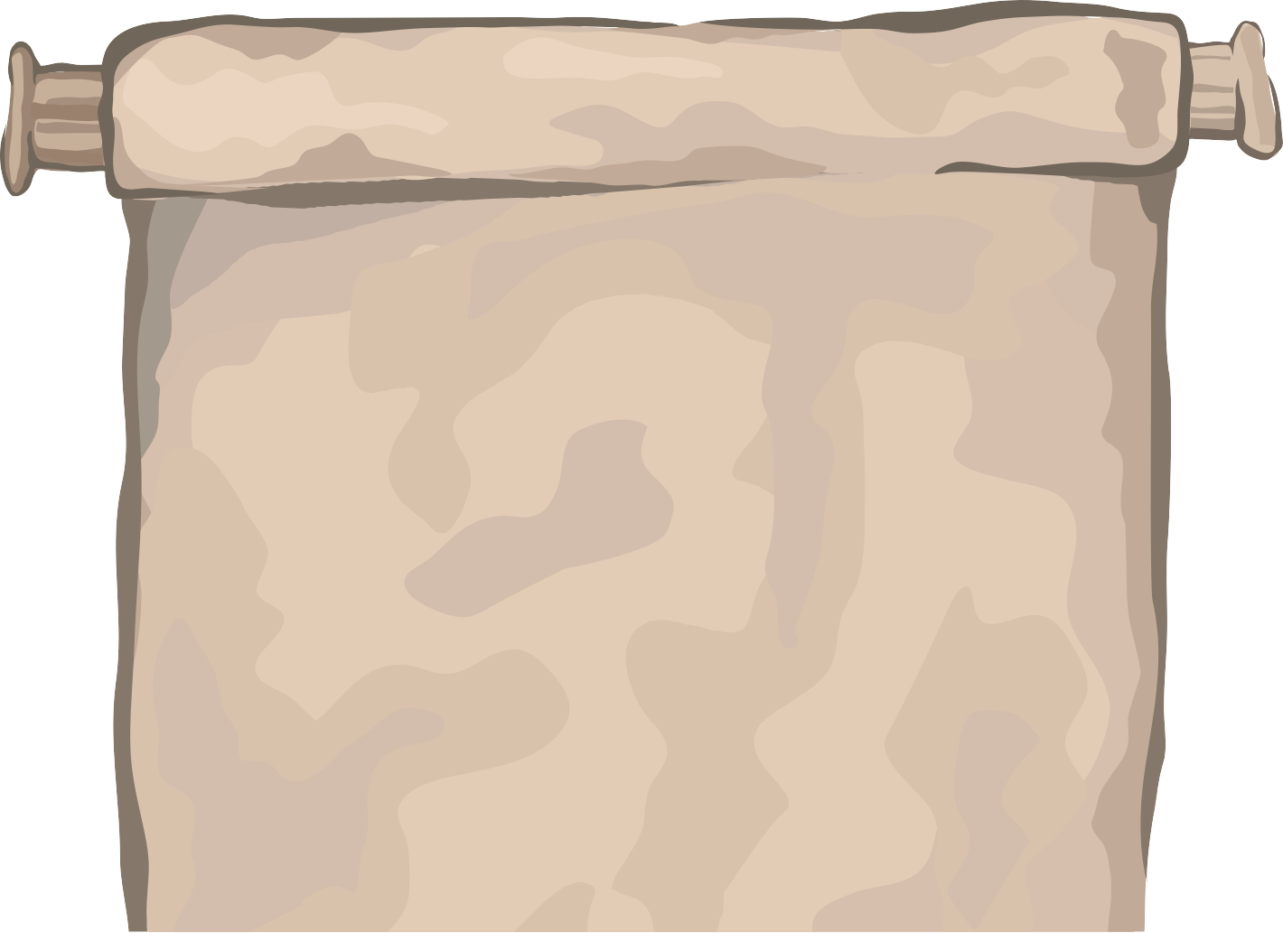

RESULTS
The results of the project will be evaluated through:
Qualitative assessment Quantitative metrics User feedback and surveys
By providing a comprehensive and detailed approach to generative landscape painting generation using GANs, this project aims to contribute significantly to the fields of AI-generated art, digital content creation, and creative tool development.

Slide 11
THANK YOU

